Slide 1
Data Science Lecture – 3 : Using Control Statements and Functions in Matlab

Slide 2
- User Defined Functions - Flow Control Statements - Questions

Slide 3
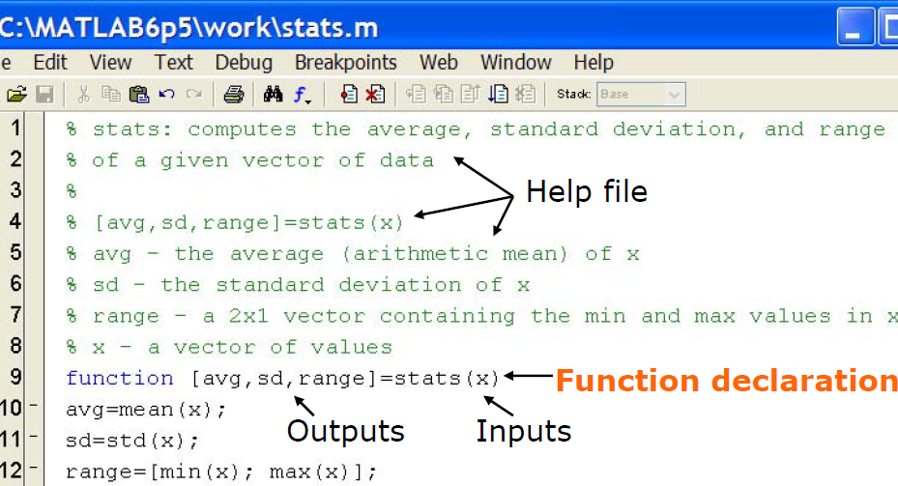
User Defined Functions in Matlab
Functions look exactly like scripts, but for ONE difference
Functions must have a function declaration
Script file has to be the Name of the function!

Slide 4
User Defined Functions - Comments
Some comments about the function declaration
function [x, y, z] = funName(input1, input2)
Must have the Outputs Function name Inputs
word: function has to same as file
No need for return: MATLAB 'returns' the variables whose names match those in the function declaration
Variable scope: Any variables created within the function but not returned disappear after the function stops running

Slide 5
User Defined Functions
Functions have 3 main stages: Inputs, Processing, Outputs
Question: implement a function to find the sum and difference of two numbers, a and b
Answer: Flow Chart Matlab code:
INPUTS
a, b
function[s,d] = sd2n(a,b)
s = a + b;
d = a – b;
end
Test case:
a = 15; b = 7;
[g, h] = sd2n(a,b);
s = a + b d = a – b
PROCESSING
OUTPUTS
s, d

Slide 6
- User Defined Functions - Flow Control Statements - Questions

Slide 7
Relational and Logical Operators
Relational Operators
Equal | ==
Not equal | ~=
Greater than | >
Less than | <
Greater or equal | >=
Less or equal | <=
Logical Operators
And | &&
Or | ||
Not | ~
Xor | xor
All true | all
Any true | any
Boolean values: zero is false, nonzero is true
See help for detailed and up-to-date list of operators

Slide 8
If/else/elseif
Basic flow-control, common to all languages
In MATLAB syntax - there is no need for parentheses
IF
if condition
commands
end
ELSE
if condition
commands1
else
commands2
end
ELSEIF
if cond1
commands1
elseif con2
commands2
else
commands3
end
Conditional statement: evaluates to true or false

Slide 9
for Loop
For Loops: these use a known number of iterations
MATLAB syntax:
Loop variable
Incremental value
for n=1:2:100
commands
end
Command block
The loop variable can be defined as a vector whose values are not consecutive. (but it is usually simpler to trouble shoot if they are consecutive)

Slide 10
while Loop
while Loops: these are like a more general for loop:
Don’t need to know the number of iterations!
while condition
commands
end
Command block
The command block will execute while the conditional expression is true
Beware of infinite loops!

Slide 11
- User Defined Functions - Flow Control Statements - Questions

Slide 12
Question-1:
Find all of the indices of the NaN values in the age category in the Titanic dataset using a for loop
Steps:
obtain the age dataset from Titanic dataset
Examine each element in the dataset (one at a time)
If the element is a NaN value store its index
Code: see next page

Slide 13
% 1) obtain the age dataset from Titanic dataset
ageData = train(:,6);
ageDataNum = cell2mat(ageData);
% 2) Examine each element in the dataset
noDataPts = length(ageDataNum); NaNcount = 0; NaNindex = zeros(noDataPts,1);
for i=1:1:noDataPts
value = ageDataNum(i);
% 3) If the element is a NaN value store its index
if(strcmp(num2str(value),'NaN'))
NaNcount = NaNcount + 1;
NaNindex(NaNcount,1)=i;
end
end
NaNindex = NaNindex(1:NaNcount,1);

Slide 14
Question-2: Find the indices of the NaN values in the age category in the Titanic dataset using a logical matrix
Steps:
obtain the age dataset from Titanic dataset
Obtain logical matrix indicating a 1 where a NaN is and 0 otherwise, L
Obtain a matrix containing indices of the age dataset, I
Put logical matrix inside of index matrix - I(L)
Code: See next page

Slide 15
Question 2 - Solutions
% 1) obtain the age dataset from Titanic dataset
ageData = train(:,6);
ageDataNum = cell2mat(ageData);
% 2) Obtain logical matrix indicating a 1 where a NaN is ageMissL = isnan(ageDataNum);
% 3) Obtain a matrix index of the age dataset, I
ageInd = 1:noDataPts;
ageInd = ageInd'; %transpose if you want a column
% 4) Put logical matrix inside of index matrix - I(L)
NaNindexL = ageInd(ageMissL);

Slide 16
Question-3: find indices of persons from original dataset that have ages between 35 and 55, using a for loop
Steps:
obtain the age dataset from Titanic dataset
Examine each element in the dataset (one at a time)
If the element has a age between 35 and 55, store its index
Code: see next page

Slide 17
% 1) obtain the age dataset from Titanic dataset
ageData = train(:,6);
ageDataNum = cell2mat(ageData);
% 2) Examine each element in the dataset
noDataPts = length(ageDataNum); midAgecount = 0; midAgeindex = zeros(noDataPts,1);
for i=1:1:noDataPts
value = ageDataNum(i);
% 3) If element age is between 35 & 55 store its index
if((value>34)&&(value<56))
midAgecount = midAgecount + 1;
midAgeindex(midAgecount,1)=i;
end
end
midAgeindex = midAgeindex(1:midAgecount,1);

Slide 18
Question-4: find indices of persons from original dataset that have ages between 35 and 55 using a logical matrix
Steps:
obtain the age dataset from Titanic dataset
Obtain logical matrix indicating a 1 where the age is between 35 & 55, and 0 otherwise, L
Obtain a matrix index of the age dataset, A
Put logical matrix inside of index matrix - A(L)
Code: See next page

Slide 19
% 1) obtain the age dataset from Titanic dataset
ageData = train(:,6);
ageDataNum = cell2mat(ageData);
% 2) Obtain logical matrix
midAgeL = ageDataNum>34;
midAgeU = ageDataNum<56;
MidAgeLog = midAgeL.*midAgeU;
MidAgeLog = MidAgeLog>0;
% 3) Obtain a matrix index of the age dataset, I
ageInd = 1:noDataPts;
ageInd = ageInd'; %transpose if you want a column
% 4) Put logical matrix inside of index matrix - I(L)
MidAgeindexL = ageInd(MidAgeLog);

Slide 20
Question-5: find indices of persons from original dataset that have ages between 35 and 55 using the find function
Steps:
obtain the age dataset from Titanic dataset
Obtain logical matrix indicating a 1 where the age is between 35 & 55, and 0 otherwise, L
Use the find function to obtain the indices of 1s in the logical matrix obtained in part-2 above, hence indicating where there are mid-age persons between the ages of 35 & 55
Code: See next page

Slide 21
% 1) obtain the age dataset from Titanic dataset
ageData = train(:,6);
ageDataNum = cell2mat(ageData);
% 2) Obtain logical matrix
midAgeL = ageDataNum>34;
midAgeU = ageDataNum<56;
MidAgeLog = midAgeL.*midAgeU;
MidAgeLog = MidAgeLog>0;
% 3) Use the find function to obtain the mid-age indicies
MidAgeindexF = find(MidAgeLog);

Slide 22
Question-6: find indices of persons from dataset with ages between 35 & 55 by creating your own function
See next 2 slides for flow chart, and solution

Slide 23
Question-6: find indices of persons from dataset with ages between 35 & 55 by creating your own function
INPUTS
Dataset, Lower-Age, Upper-Age
Obtain logical matrix indicating a 1 where age is between Lower-Age & Upper-Age, and 0 otherwise, L
Obtain a matrix index of the age dataset, A
Put logical matrix inside of index matrix - A(L)
PROCESSING
OUTPUTS
Indices of persons within input ages

Slide 24
% function finds persons that are mid-age from a dataset
function[midAgeInd] = midAge(data,ageL,ageU)
%1) obtain logical matrix- assume data is a col vector
midAgeL = data>=ageL;
midAgeU = data<=ageU;
MidAgeLog = midAgeL.*midAgeU;
MidAgeLog = MidAgeLog>0;
% 2) obtain index matrix
noDataPts = length(data);
ageInd = 1:noDataPts;
ageInd = ageInd';
% 3) put logical matrix inside of index matrix
midAgeInd = ageInd(MidAgeLog);
end

